Slide 1
Advanced Training
Mail: florian.jacta@taipy.io

Slide 2
Summary
Taipy GUI:
Decimator for large data
Partials
Long callbacks
Python expressions
Stylekit and CSS
Structure of an application
Taipy Core:
Skippability and Scope
Intermediary Data Node (Pickle)
Generic Data Node
Taipy Studio
The goal of this training is to go through the more advanced Taipy concepts

Slide 3

Taipy GUI
Taipy GUI:
Decimator for large data
Partials
Long callbacks
Python expressions
Stylekit and CSS
Structure of an application

Slide 4
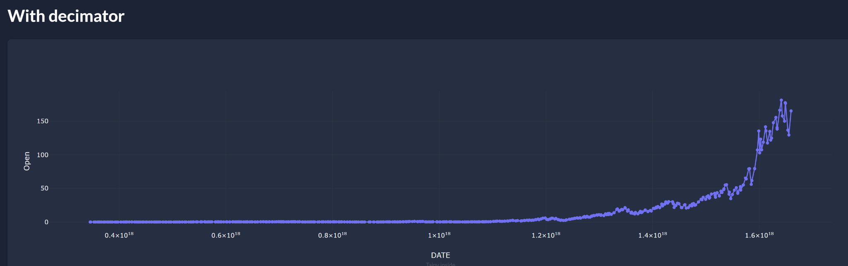
Decimator
Sum up:
A way to display large data
Code:
1 Decimator

Slide 5
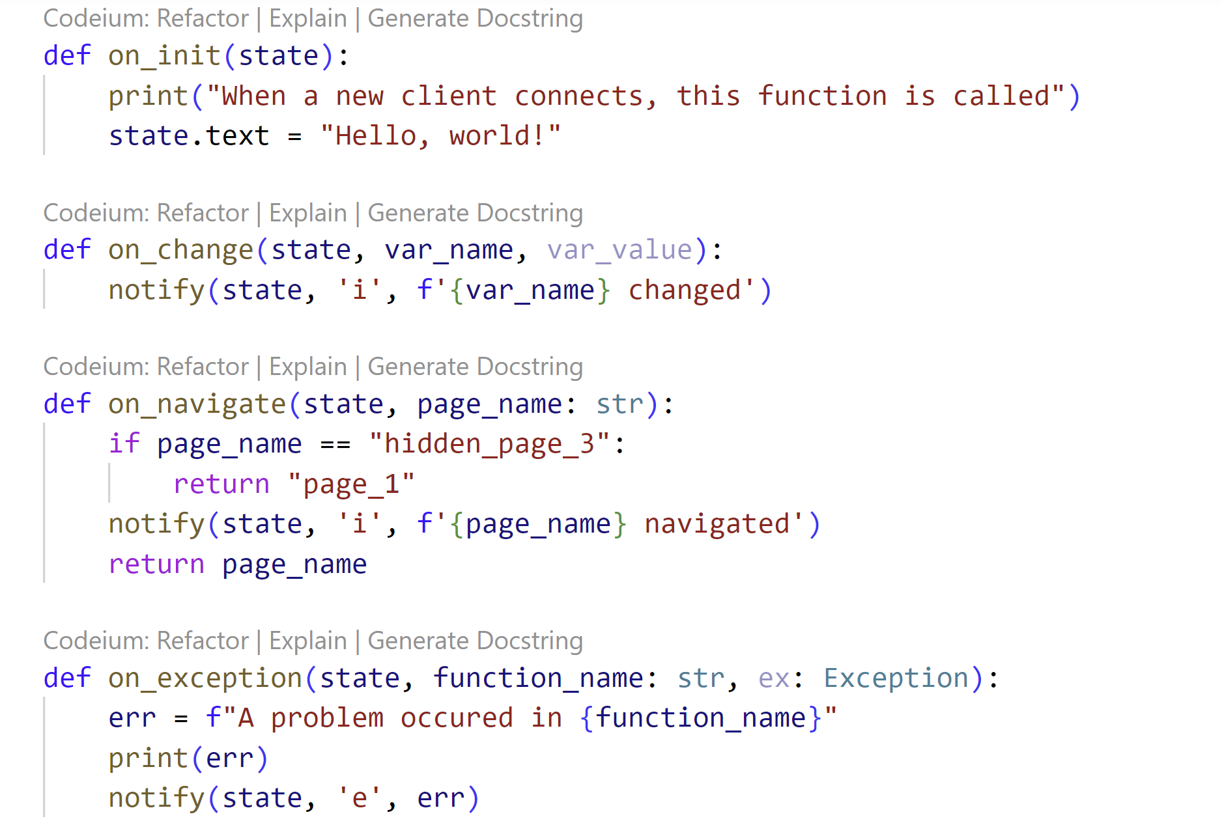
Callbacks
Sum up:
There are basic functions that can be used to modify the default behaviour of Taipy GUI:
On init: initialize a connection (refresh)
On navigate: protect pages
…
Code:
2 Callbacks
Ressources:
On change
On init
On exception
On navigate

Slide 6
Long callbacks
Sum up:
Certain function can take a lot of time to execute. If the function takes too much time, the Web Server disconnects. We need to use a long callback.
This system lets Taipy always be interactive and not blocked by any function.
Code:
3 Long Callbacks
Ressources:
Long Running Callbacks

Slide 7
Partials
Sum up:
Ability to generate Markdown in run-time. It is useful if a part of the Markdown is dynamic or has to be rebuild from scratch.
Code:
4 Partial
Ressources:
Partials
Update content

Slide 8
Python expressions and adapter for selectors
Sum up:
Using Python expressions directly in the Markdown will make coding much more efficient and simple. Using the adapter will also let you manipulate the appropriate object in Taipy GUI
Code:
5 Adapter
6 Python expression
<|{text if text else 'Write something in the input'}|>
<|{text}|input|on_change={lambda s: notify(s, 'i', s.text)}|>

Slide 9
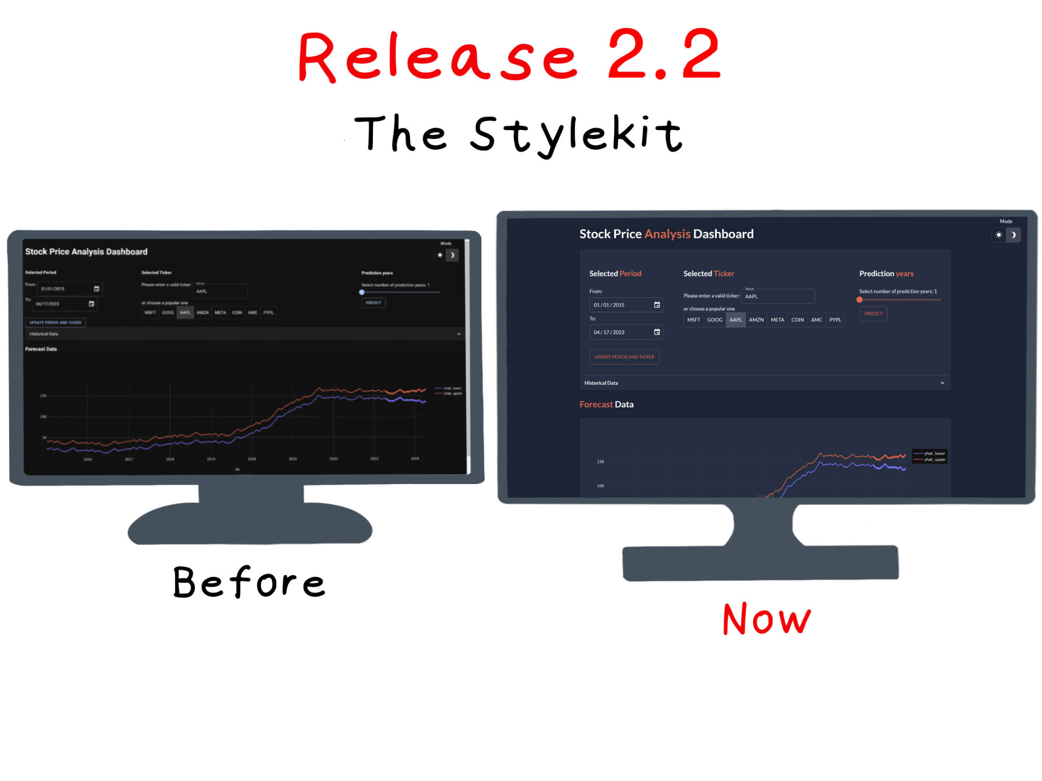
Stylekit and CSS
Sum up:
Three major components:
Container
Card
Sidebar
Possibility to add predefined CSS class.
Possibility to change the theme
Code:
8 Stylekit
Ressources:
Introducing the CSS Stylekit
Stylekit

Slide 10
Structure of an application
algos/
algos.py
config/
config.py
config.toml
data/
ex_data.csv …
pages/
root or shared/
root.py
root.md
page_1/
page_1.md
page_1.py
page_2 /…
main.py
main.css
Sum up:
Embodying the Markdown by the Markdown object will give a Scope to the variable
Code:
7 Structure-Scope-Multipage
Ressources:
Scope for variable binding

Slide 11
Taipy Core
Taipy Core:
Skippability and Scope: Understand Taipy Core in detail and learn how to skip tasks in a workflow.
Intermediary Data Node (Pickle)
Generic Data Node: Learn how to incorporate any data source in Taipy Core.
Taipy Studio: Learn how to use it

Slide 12
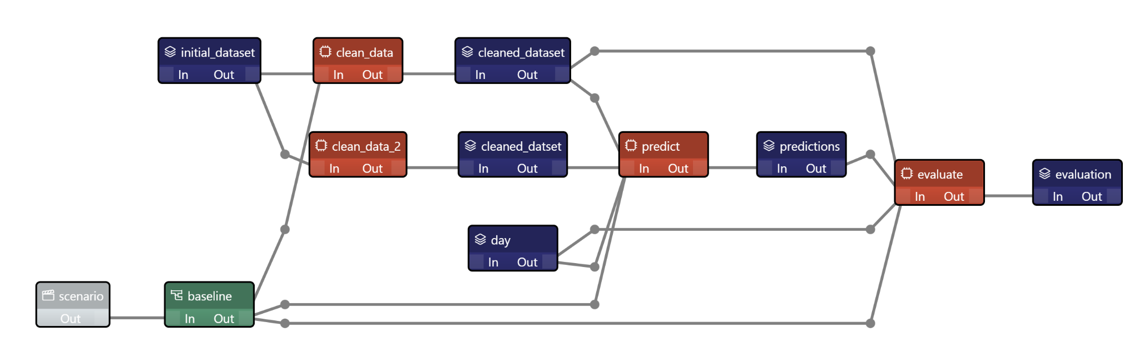
Taipy Studio
Sum up:
Go through the usage of Taipy Studio: a way to create graphically Pipelines, Data nodes, Tasks, …
Ressources:
Studio Config

Slide 13
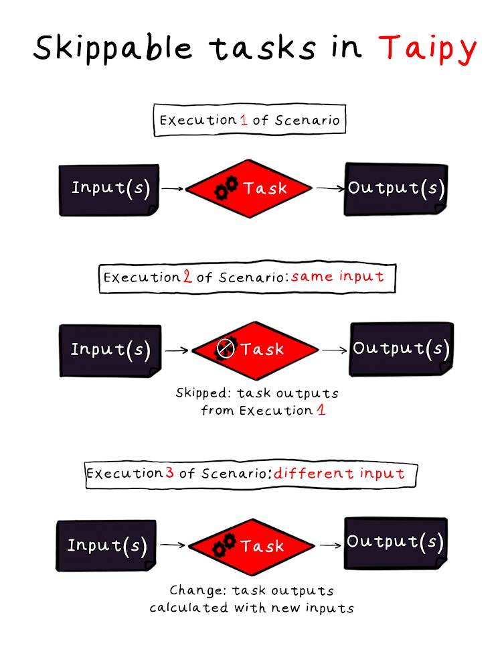
Skippability and Scope
Sum up:
Go through the basics of Taipy to understand why a Task can be skipped.
Code:
core
Ressources:
Simplifying complex workflows with Taipy skippable Tasks

Slide 14
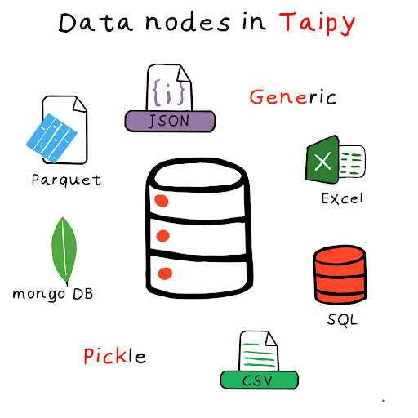
Intermediary and Generic Data Node
Sum up:
Focus on what is a Data Node and how to write one ourselves
Code:
core
Ressources:
Data node
Data node config
Entities and scenario creation

